Slide 1


Machine Learning Deployment and Integration on Linux Server
PT SARANA MAJU LESTARI

Slide 2
TOPICS
Database Connection
Connecting to the database to integrate with real-time data.
Integration with Flask
Integrating your machine learning model with Flask.
Learn how to expose your ML model as a RESTful API.
Containerization with Docker
Benefits of Containerization with Docker.
Example of Containerization on the Linux platform.

Slide 3
Prerequisite
Before starting this submodule, make sure you have the following prerequisites:
Database Setup A running database (e.g., MySQL, PostgreSQL) with sample data for integration.
Docker Installation Docker installed on your local machine or the server where you plan to deploy the machine learning system. You can install Docker by following the instructions on the Docker documentation page (https://docs.docker.com/get-docker/).
Basic Flask Knowledge Understanding the basics of Flask for web service development. If you are new to Flask, consider checking the Flask documentation on the Flask documentation page (https://flask.palletsprojects.com/en/3.0.x/).
VS Code VS Code as the code editor, but it can be replaced with another application.
DBeaver Installation A helpful application for easy database access with an interactive UI. It can be downloaded from its official website (https://dbeaver.io/download/).

Slide 4
Database Preparation
We are using Database db_bat_blk2 on this sample project, with these table specification:
tb_bat_raw: realtime sensor data that will act as ML input.
tb_efficiency_conf_tags: Efficiency configuration tags
tb_efficiency_result: Efficiency prediction results

Slide 5
Connect MySQL Database with Python
MySQL Database can be connected to Python using one of the following libraries:
PyMysql
Mysql-connector-python
SQLalchemy

Slide 6
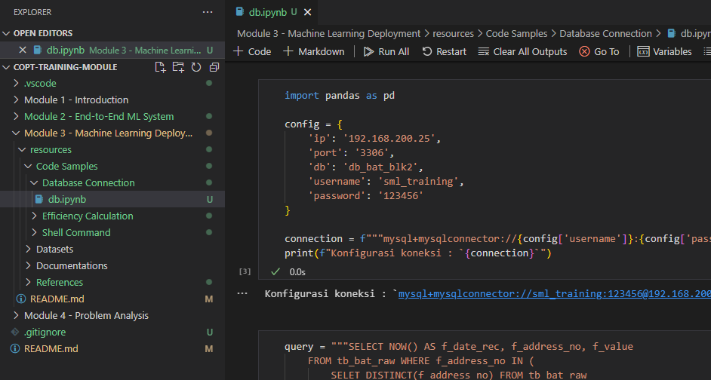
Connect MySQL Database with Python
We can try to connect with MySQL database using this notebook:
Module 3 - Machine Learning Deployment\resources\Code Samples\Database Connection\db.ipynb
Here we try to read a realtime data from database.

Slide 7
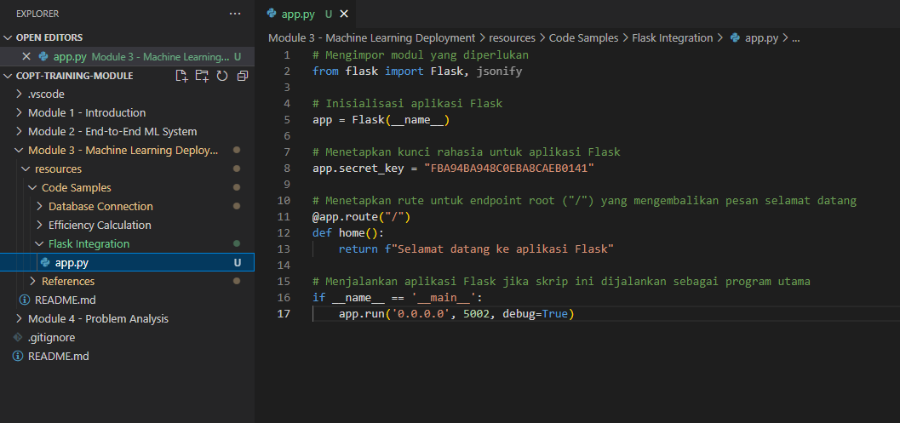
Integration with Flask
We use Flask as an interface with another application. You can try using Flask Application on this file:
Module 3 - Machine Learning Deployment\resources\Code Samples\Flask Integration\app.py

Slide 8



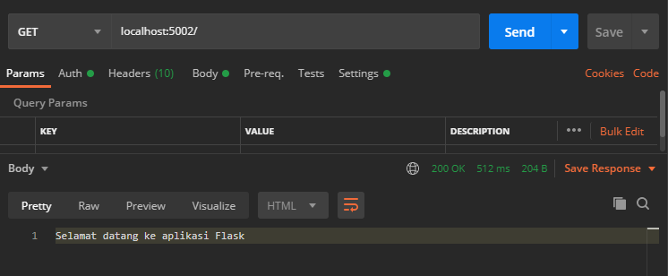
Integration with Flask
To try Flask inegration, you can use Postman, or Google Chrome. Run app.py, then open this url with Postman or Google Chrome:
http://localhost:5002/
The result will be like this:

Slide 9
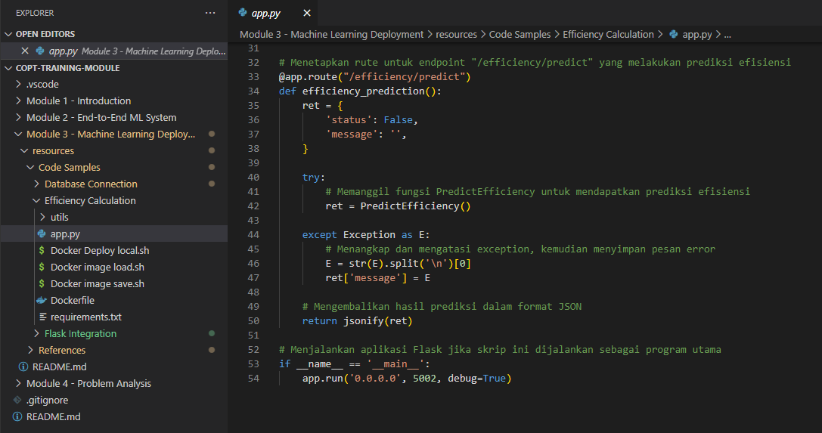
Integrate ML Application with Flask
Module 3 - Machine Learning Deployment\resources\Code Samples\Efficiency Calculation\app.py

Slide 10
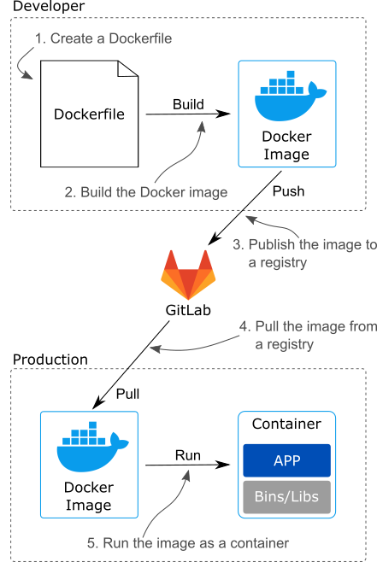
Containerization with Docker
A Docker container serves to package an application into a container, allowing the application to run consistently despite differences in the environment.
Once the application can run smoothly on localhost, it can be deployed using Docker, and its environment is adjusted to match that of localhost.

Slide 11
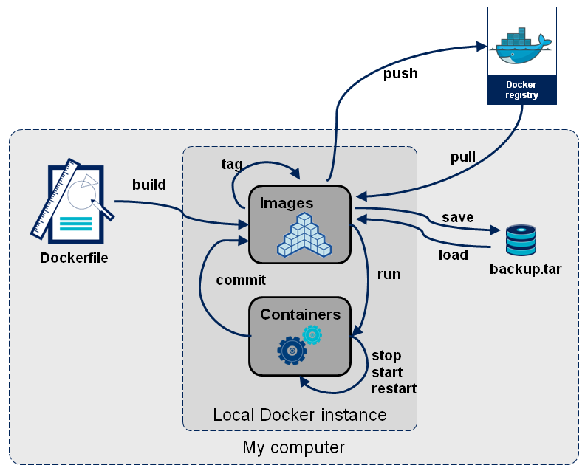
Containerization with Docker

Slide 12
Containerization with Docker
You can deploy the application on your local machine, or deploy into another machine
1. Deploy apps into local Docker Container :
$ docker build -t efficiency_pred:v1.0 .
$ docker run -itd --name efficiency_pred --restart unless-stopped --memory="2G" -p 0.0.0.0:5002:5002 efficiency_pred:v1.0
2. Deploy into another machine
Save Docker Container into file:
$ docker build -t efficiency_pred:v1.0 .
$ docker image save -o ../efficiency_pred_v1.0.tar efficiency_pred:v1.0
Transfer to another machine
$ rsync –avP ../efficiency_pred_v1.0.tar 192.168.200.25:~/.
Open Docker Container file and run on another server:
$ docker stop efficiency_pred
$ docker rm efficiency_pred
$ docker image rm efficiency_pred:v1.0
$ docker image load -i ../efficiency_pred_v1.0.tar
$ docker run -itd --name efficiency_pred --restart unless-stopped --memory="2G" -p 0.0.0.0:5002:5002 efficiency_pred:v1.0

Slide 13
Containerization with Docker
Show all running docker container with this command:
$ docker ps -a

Slide 14
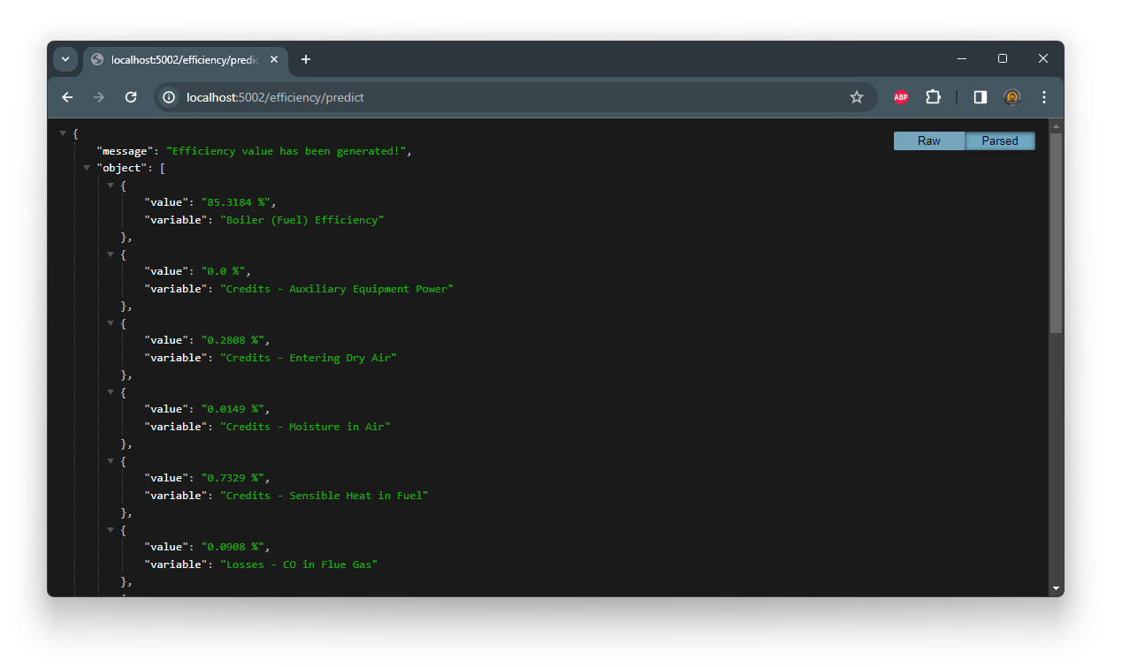
ML Apps Testing after Integrated with Docker and Database
After docker image is deployed, call this URL to star the ML Apps:
http://localhost:5002/efficiency/predict

Slide 15
Thank You

